Slide 1
Computing distance of a point to triangle
ycw
20230719

Slide 2
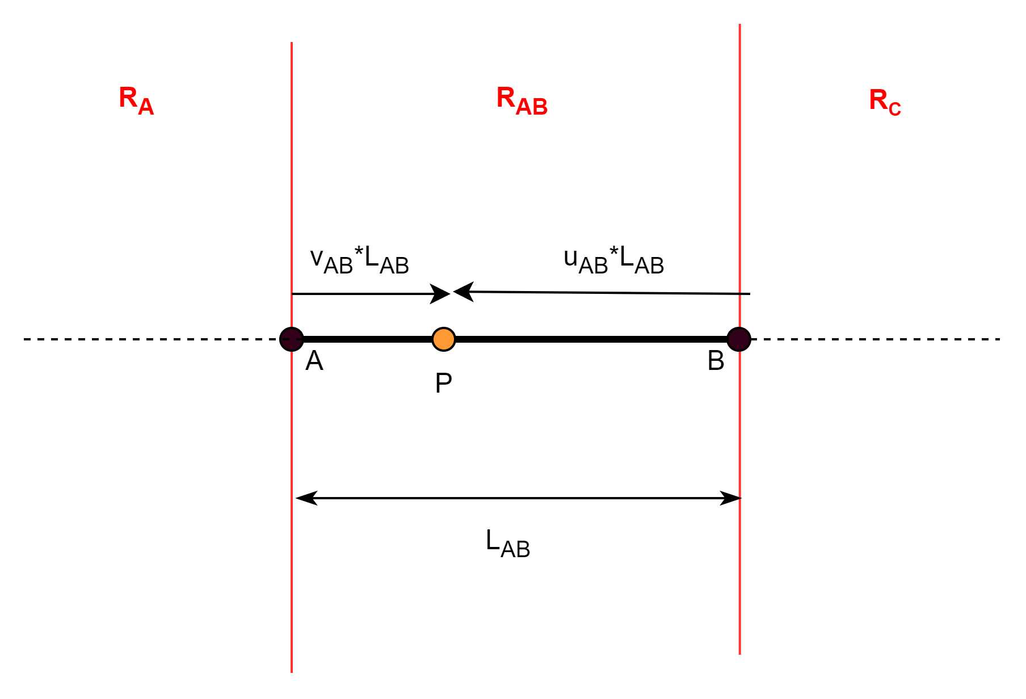




Barycentric coordinates of a point on a line
$$u_{AB}≥0$$
$$v_{AB}<0$$
$$u_{AB}≥0$$
$$v_{AB}≥0$$
$$u_{AB}<0$$
$$v_{AB}≥0$$
$$P\left(u_{AB},v_{AB}\right)=u_{AB}A+v_{AB}B$$
$u_{AB}+v_{AB}=1$
$u_{AB}$ and $v_{AB}$ are the barycentric coordinates of $P$.
$u_{AB}$ and $v_{AB} are weights on A and B respectively to give P$
Barycentric regions gives the Voronoi regions for a line.
The signs of $u_{AB}$ and $v_{AB}$ can be used to determine the Voronoi region point $P$ is located.

Slide 3
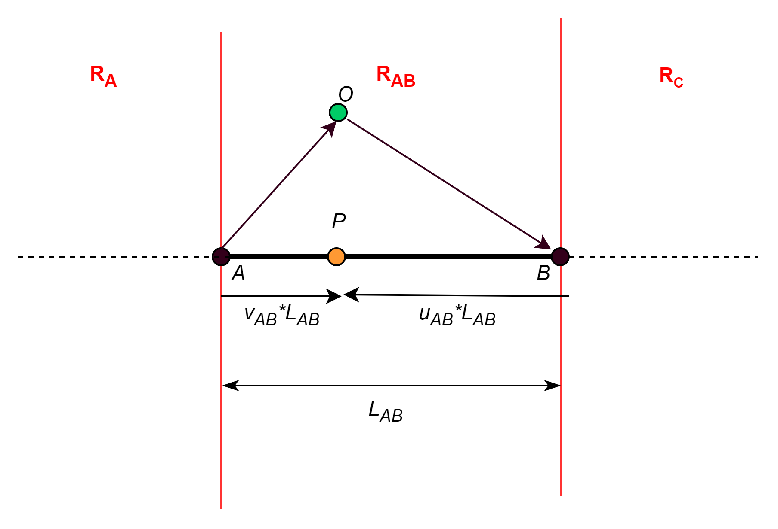










Distance of a point to a line
Given point O, find nearest distance to line AB.
${\hat{d}}_{AB}=\frac{\overset{⃑}{AB}}{\left|\overset{⃑}{AB}\right|}$ = $\frac{\overset{⃑}{AB}}{L_{AB}}$
$$\overset{⃑}{AO}$$
$$v_{AB}=\frac{\overset{⃑}{AO}∙ {\hat{d}}_{AB}}{L_{AB}}=\frac{\overset{⃑}{AO}∙\overset{⃑}{AB}}{L_{AB}^{2}}$$
$$\overset{⃑}{OB}$$
$$u_{AB}=\frac{\overset{⃑}{OB}∙ {\hat{d}}_{AB}}{L_{AB}}=\frac{\overset{⃑}{OB}∙\overset{⃑}{AB}}{L_{AB}^{2}}$$
Determine Voronoi region point O is located in.
If in R_{A}, vertex A would be the nearest point to O:
$l_{NEAREST}=\left|\overset{⃑}{AO}\right|$
If in R_{B}, vertex B would be the nearest point to O:
$l_{NEAREST}=\left|\overset{⃑}{OB}\right|$
If in R_{AB}, point $P=u_{AB}A+v_{AB}B$ would be nearest:
$l_{NEAREST}=\left|\overset{⃑}{PO}\right|$
$${\overset{⃑}{d}}_{AB}$$
$$u_{AB}≥0$$
$$v_{AB}<0$$
$$u_{AB}≥0$$
$$v_{AB}≥0$$
$$u_{AB}<0$$
$$v_{AB}≥0$$

Slide 4
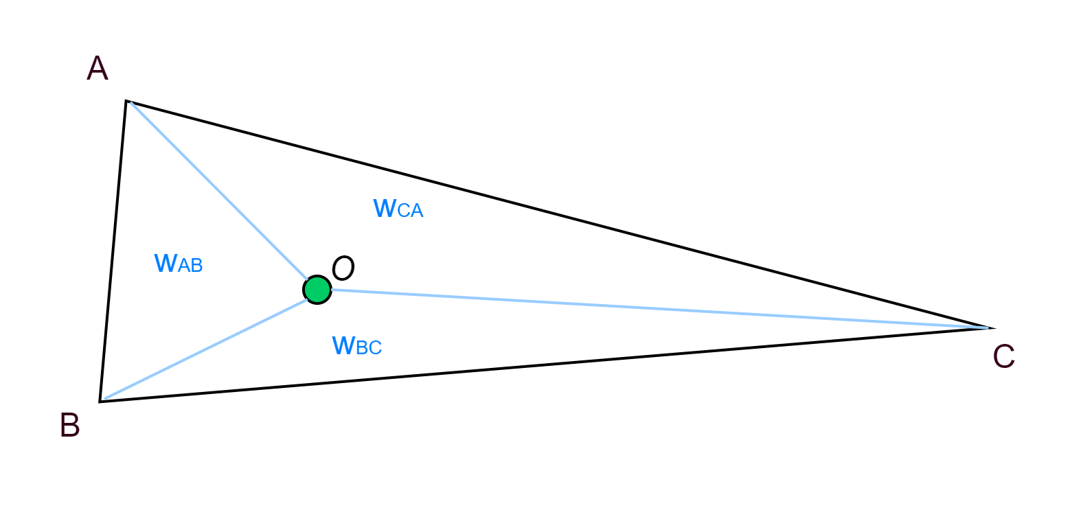

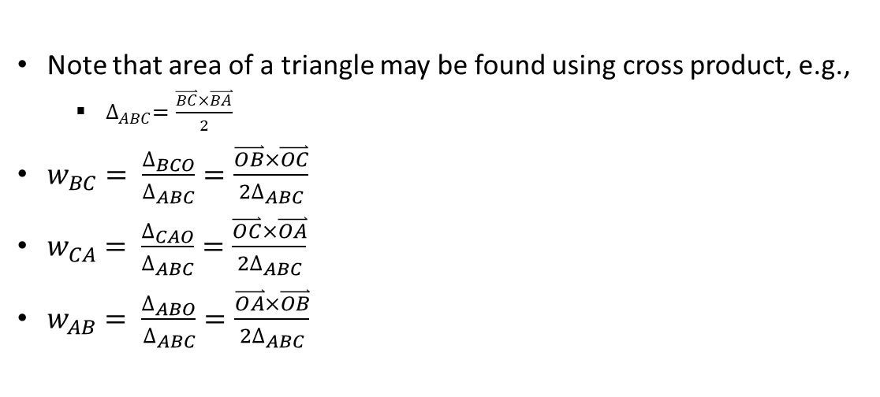

Barycentric coordinates of a point in a triangle
$O=w_{BC}A+w_{CA}B$ $+w_{AB}C$
$w_{BC}+w_{CA}$ $+w_{AB}=1$
Note that area of a triangle may be found using cross product, e.g.,
$∆_{ABC}=\frac{\overset{⃑}{BC}×\overset{⃑}{BA}}{2}$
$w_{BC}= \frac{∆_{BCO}}{∆_{ABC}}=\frac{\overset{⃑}{OB}×\overset{⃑}{OC}}{2∆_{ABC}}$
$w_{CA}= \frac{∆_{CAO}}{∆_{ABC}}=\frac{\overset{⃑}{OC}×\overset{⃑}{OA}}{2∆_{ABC}}$
$w_{AB}= \frac{∆_{ABO}}{∆_{ABC}}=\frac{\overset{⃑}{OA}×\overset{⃑}{OB}}{2∆_{ABC}}$

Slide 5
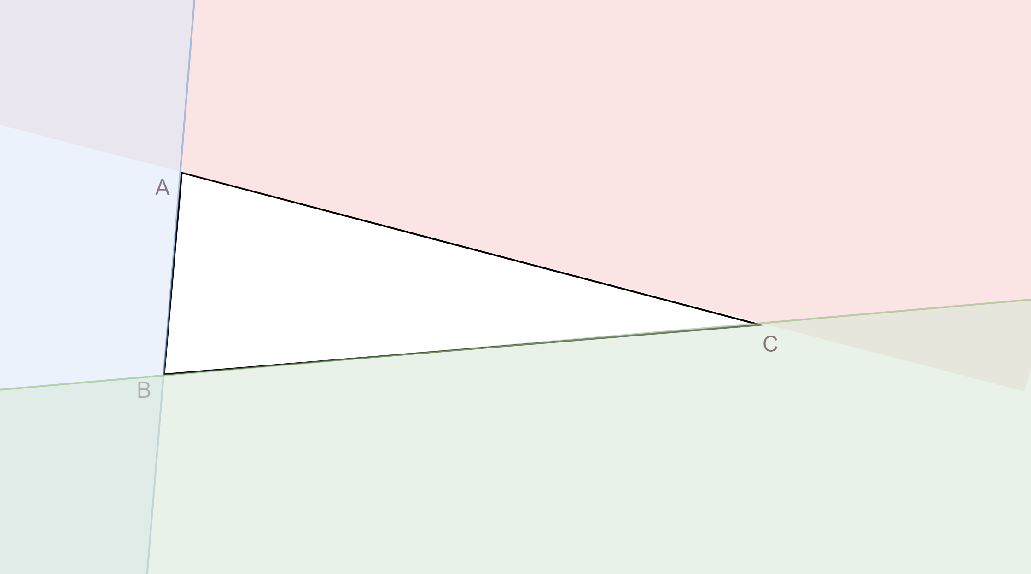




Barycentric regions for point O
The barycentric region in which point O is located can be determined from the barycentric coordinates.
Note that barycentric regions are not mutually exclusive.
$$w_{CA}<0$$
$$w_{AB}<0$$
$$w_{CA}≥0$$
$$w_{AB}≥0$$
$$w_{BC}≥0$$
$$w_{BC}<0$$

Slide 6
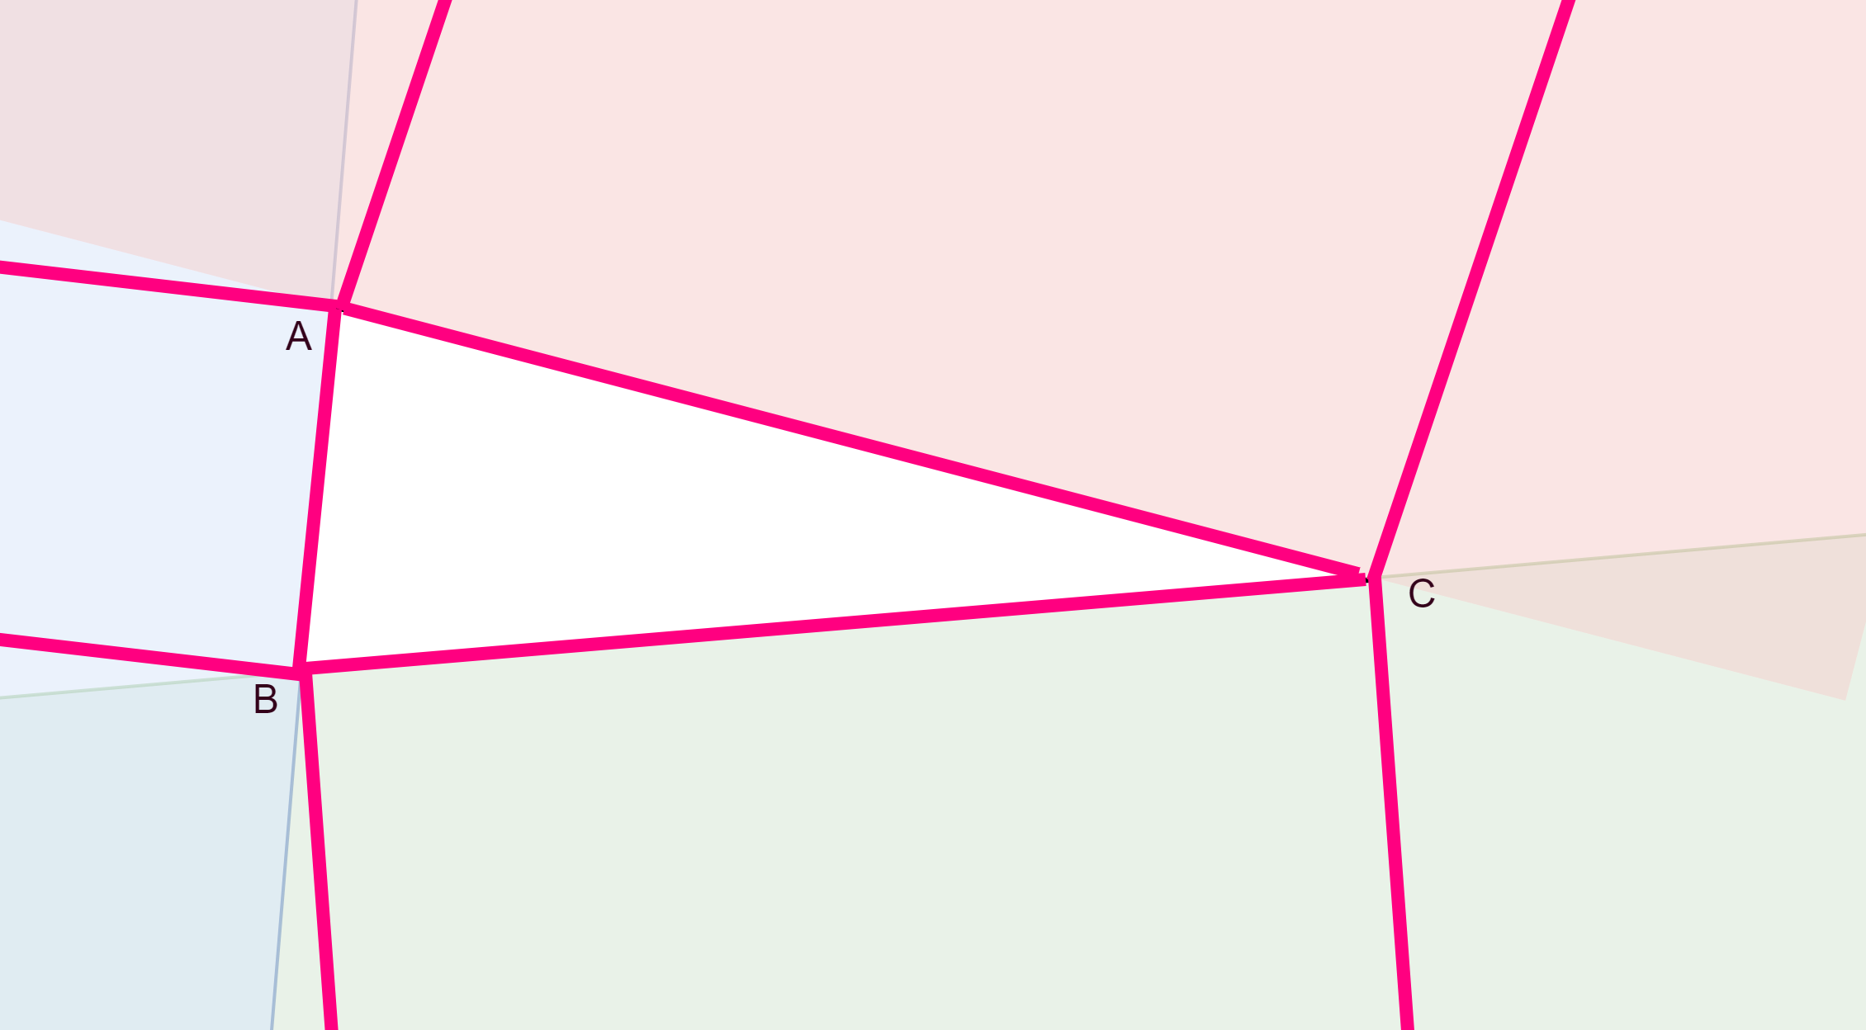



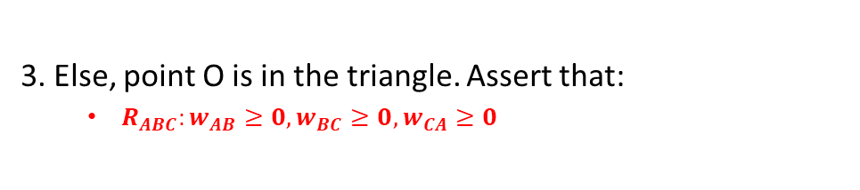

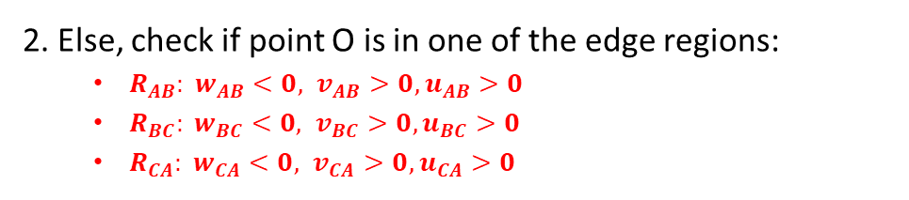

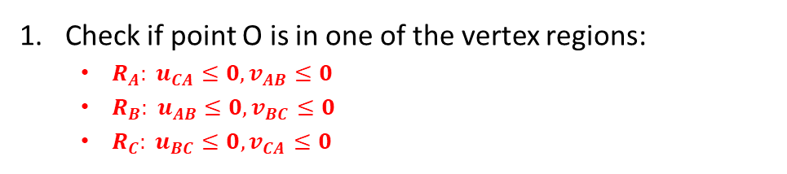


Voronoi regions and barycentric regions
Problem statement:
Given point O and triangle ABC, find the nearest point on triangle to point O.
Determine the distance.
$$R_{A}$$
$$R_{CA}$$
Check if point O is in one of the vertex regions:
$R_{A}: u_{CA}≤0,v_{AB}≤0$
$R_{B}: u_{AB}≤0,v_{BC}≤0$
$R_{C}: u_{BC}≤0,v_{CA}≤0$
$$R_{AB}$$
$$R_{ABC}$$
$$R_{C}$$
2. Else, check if point O is in one of the edge regions:
$R_{AB}: {w_{AB}<0, v}_{AB}>0,u_{AB}>0$
$R_{BC}: {w_{BC}<0, v}_{BC}>0,u_{BC}>0$
$R_{CA}: {w_{CA}<0, v}_{CA}>0,u_{CA}>0$
$$R_{B}$$
$$R_{BC}$$
3. Else, point O is in the triangle. Assert that:
$R_{ABC}:w_{AB}≥0,w_{BC}≥0,w_{CA}≥0$

Slide 7
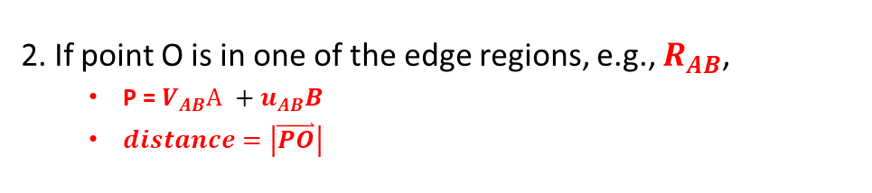
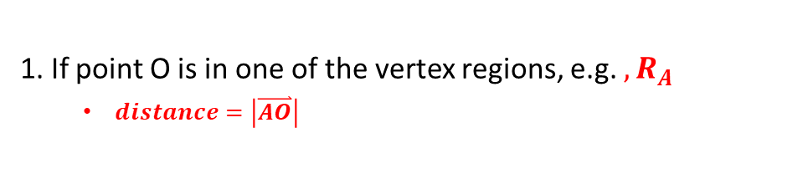
Voronoi regions and barycentric regions
For nearest distance calculations:
$$R_{A}$$
1. If point O is in one of the vertex regions, e.g. $, R_{A}$
$distance=\left|\overset{⃑}{AO}\right|$
$$R_{CA}$$
$$R_{AB}$$
$$R_{ABC}$$
2. If point O is in one of the edge regions, e.g., $R_{AB}$,
P = ${V_{AB}\text{A} +u}_{AB}B$
$distance=\left|\overset{⃑}{PO}\right|$
$$R_{C}$$
$$R_{B}$$
$$R_{BC}$$

